Slide 1
DALAC
Workspace Management System
David Luco, Anita Sharma, Collin Sullivan, Amanda Ali, Luke Stigdon

Slide 2
Overview
This goal of this project is to provide the following benefits:
More efficient utilization of office space
Reduce costs spent on new spaces that are unnecessary
Increase employee productivity through work environment flexibility

Slide 3
ER Diagram

Slide 4
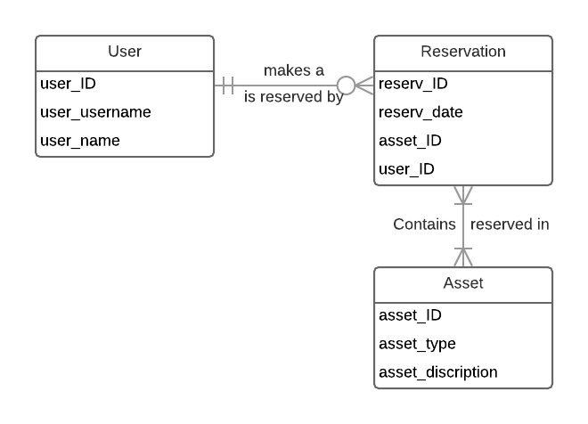
ER Diagram
A user is an employee of the company, either a basic employee, member of the HR department, or upper management. Each user is able to create a reservation for work space or objects. HR and upper management users have special functions available to them to maintain and control their workers.
A reservation is created to reserve a workspace or work object for an employee. Reservations cannot overlap for the same user but can be reserved for extended periods of time. Reservations can be made on mobile and desktop applications.
An asset is either a room in the building or a piece of equipment that can be reserved for use. Each asset must be reserved and cannot be used for extend time unless it is reserved again.

Slide 5
Individual Alternative Matrices

Slide 6
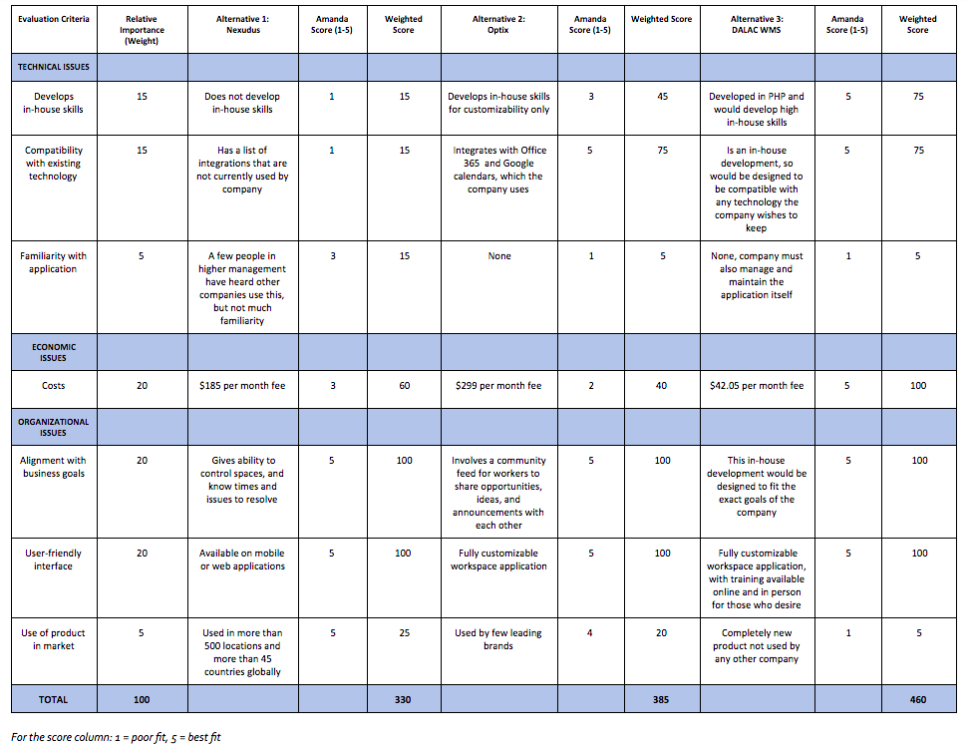
Amanda’s Alternative Matrix

Slide 7
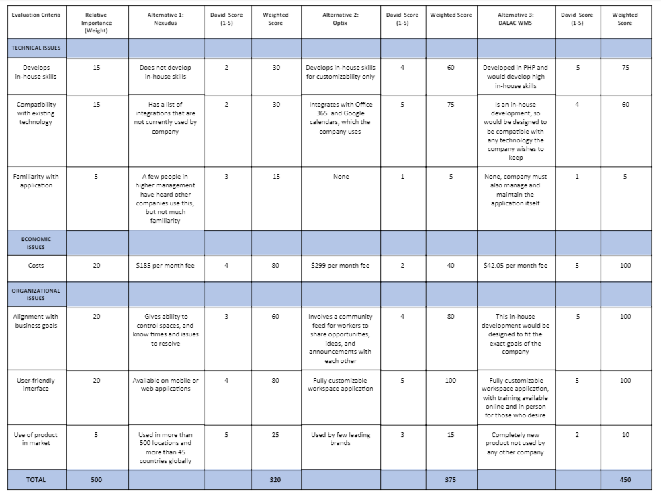
David’s Alternative Matrix

Slide 8
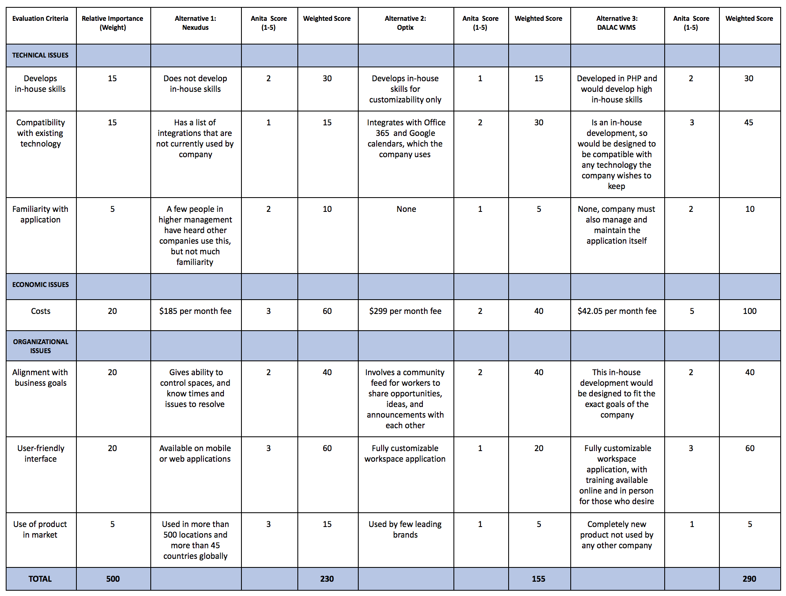
Anita’s Alternative Matrix

Slide 9
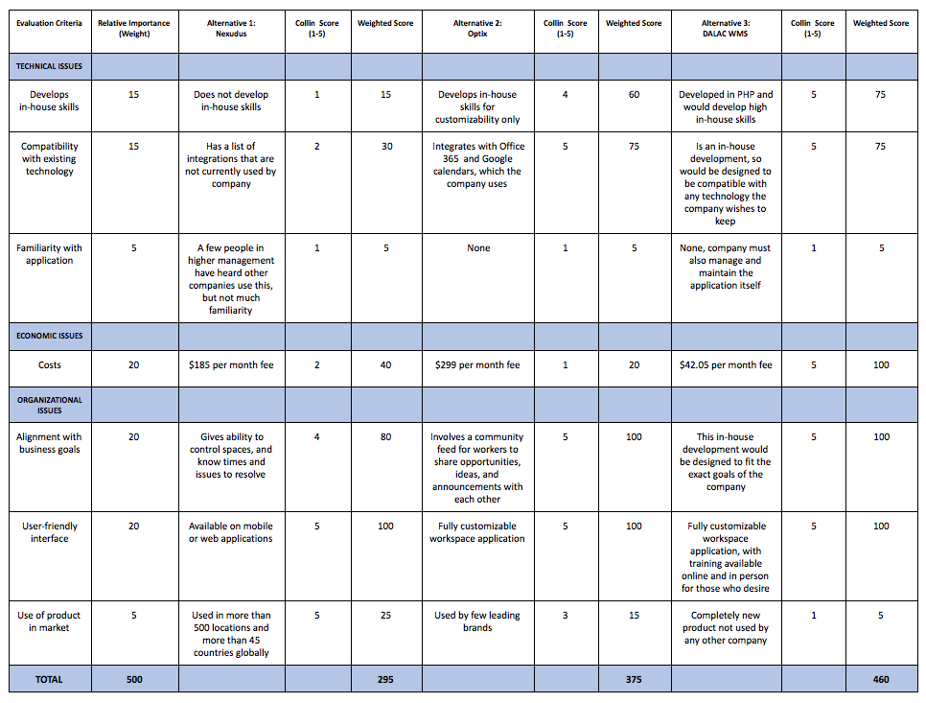
Collin’s Alternative Matrix

Slide 10
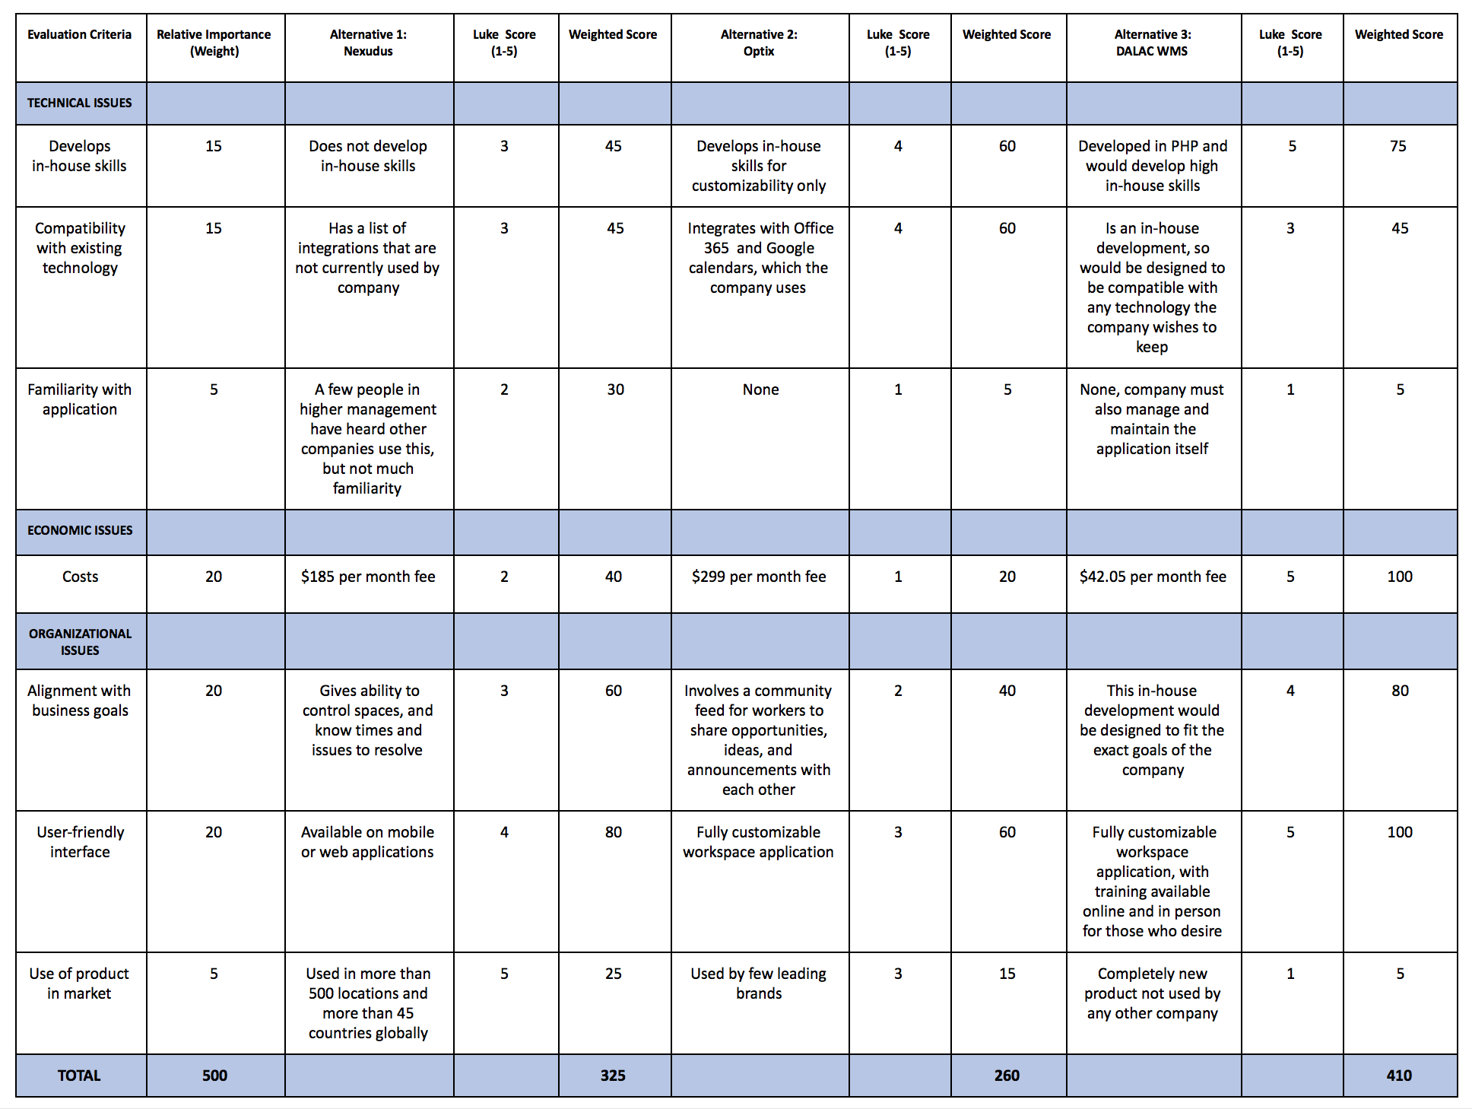
Luke’s Alternative Matrix

Slide 11
Team Alternative Matrix

Slide 12
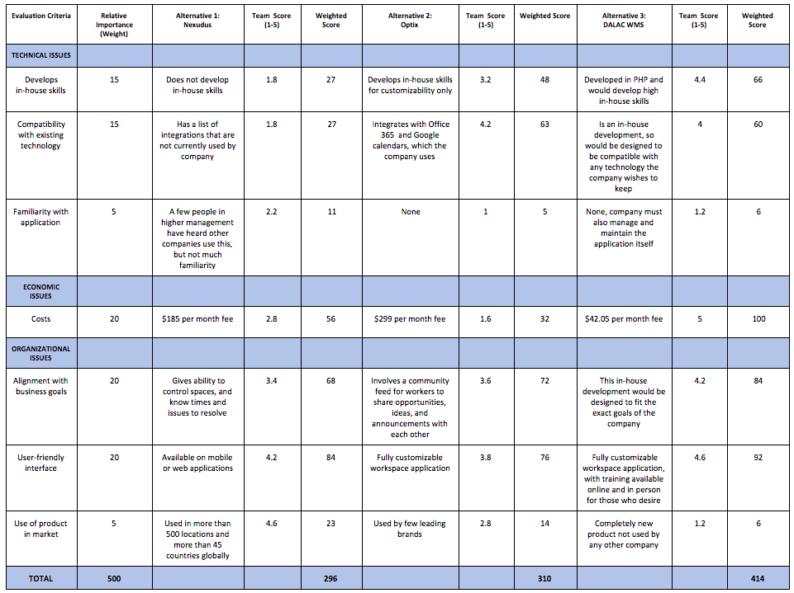
Team Alternative Matrix

Slide 13
Architecture Matrix

Slide 14
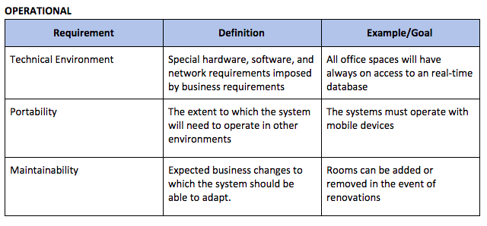
Architecture Matrix

Slide 15
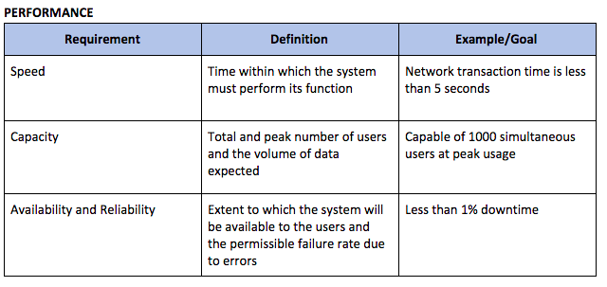
Architecture Matrix

Slide 16
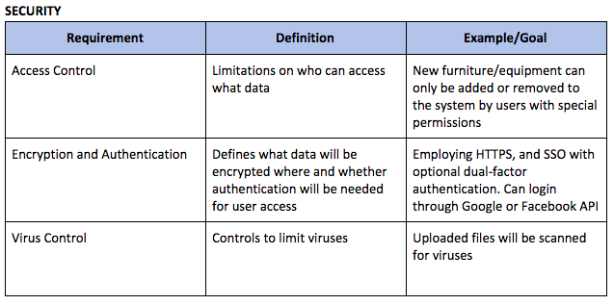
Architecture Matrix

Slide 17
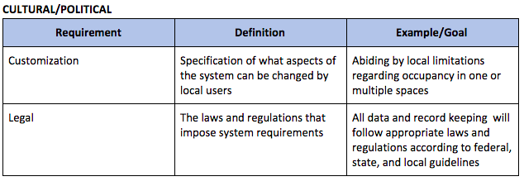
Architecture Matrix

Slide 18
Decision of System Architecture

Slide 19
Decision of System Architecture
Reasons for selecting client-server model:
Provides higher scalability
Increased productivity
Easy maintenance
Security
Remote access
Disadvantages of using client-server model:
Off premises hosting solutions can impact availability
Security/Privacy considerations when hosting data remotely

Slide 20
Hardware and Software Specification

Slide 21
Hardware and Software Specification
Hardware
AWS EC2 Instance (t2.small) - or equivalent
AWS RDS Instance (db.t2.small) - or equivalent
Software
Operating system: CentOS
Database Engine: MySQL
Web Application: PHP >= 7.1
Laravel Framework 5.6
Web Server: Nginx or Apache
Client: Any modern web browser (e.g. Firefox, Chrome, Edge, Safari)

Slide 22
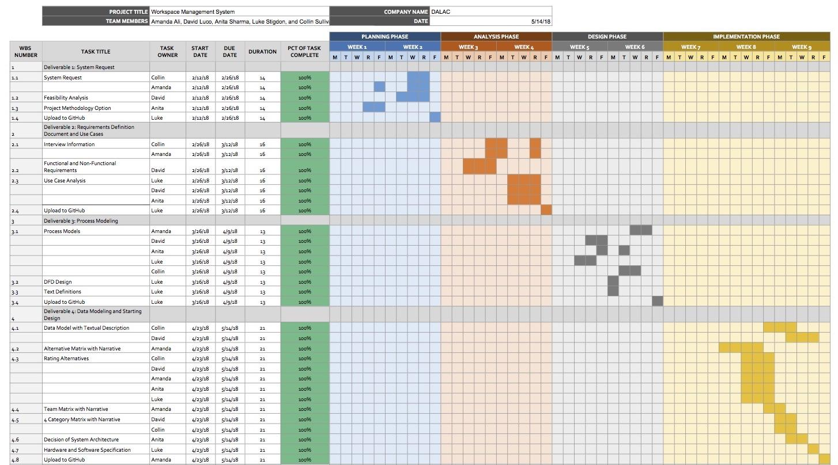
Updated Project Plan

